Slide 1
Sequential mergers under product differentiation in a partially privatized market
Takeshi Ebina, Shinshu University
Daisuke Shimizu, Gakushuin University
Industrial Organization workshop
October 19, 2016, THE University of Tokyo

Slide 2
Today’s presentation
1. Introduction
2. Basic Model
3. Equilibrium
4. Full Model
5. Numerical Analysis
6. Conclusion

Slide 3
1. Introduction: Sequential mergers
1. Introduction
Sequential Mergers have become prominent in recent years.
What are sequential mergers?
⇒ One set of firms merging leads to more cases of mergers in the same industry.
Examples: pharmaceuticals, banking, insurance, steel, department stores, convenience stores, games.
When one set of merger is considered, the participants (including the AA, Antitrust Authorities) must consider not just the myopic incentives, but how the market structure would eventually evolve to become.

Slide 4
1. Introduction: Privatization
1. Introduction
Two types of competition:
  Pure oligopoly: Only private firms maximizing their profits
  Mixed oligopoly: A public firm maximizing social welfare vs. Private firms maximizing their profits
Examples of mixed oligopoly: Airline, telecommunications, natural gas, electricity, steel, banking, life insurance, broadcasting, education, …
Governments have tried to privatize public firms by selling a stock of the company to increase its efficiency or to obtain budget revenue.
⇒ Policymakers must consider both (1) merger formation propriety +
(2) optimal level of privatization

Slide 5
1. Introduction: Real example of our study
1. Introduction
Example of sequential merger + privatization: Life insurance industry in Japan
  2004: Meiji Life Insurance and Yasuda Life Insurance
  2006: Japan Post Insurance (JPI, government-owned, 1st) → mixed oligopoly
  Apr. 2014: Starting discussion on its privatization
  Jun. 2014: Dai-ichi (3rd) acquired a company.
  Jul. 2015: Meiji-Yasuda Life (5th) acquired a company.
  Aug. 2015: Sumitomo Life (4th) acquired a company.
  Sep. 2015: Nippon Life (2nd) acquired Mitsui Life (7th).
  Nov. 2015: Japan Post Insurance (JPI) on Tokyo Stock Exchange → partial privatization
Notes:
and four. （1秒あける）
Thus it is of interest to see how the existence of a public ﬁrm and its privatization would aﬀect the private ﬁrms’ incentive to sequentially merge.

Slide 6
Related literature
1. Introduction
Sequential mergers:
  Nilssen and Sørgard (1998 EER)
  Ebina and Shimizu (2009 Aus Econ P)
  Salvo (2010 Economica)
  Ebina and Shimizu (2016 Asia Pacific J of Econ & Accounting)
  → Merger partner is exogenously given. Each merger pair decides whether or not to merge once.
Nilssen and Sørgard (1998): Two sets of mergers could take place sequentially. Depending on the cost reduction from the mergers, several merger patterns may emerge.
Notes:
Thus in this paper, we consider sequential mergers in an industry with a public ﬁrm.
In this slide, before presenting our model, I’d like to mention the most related papers.

Slide 7
Related Literature
1. Introduction
Sequential mergers with product differentiation:
  Levy and Reitzes (1992), Matsushima (2001): Mergers in spatial context.
  Salvo (2010): In a setting similar to Nilssen and Sørgard (1998) but without cost synergies, two groups of firms are located apart. The mergers are cross-bordered.
  Ebina and Shimizu (2009, 2015): Used differentiated demand function in a four firm setting.
In Salvo (2010) and Ebina and Shimizu (2009, 2015), the “sequential or no mergers” result emerges.

Slide 8
Related literature
1. Introduction
Mixed oligopoly with (non-sequential) merger:
  Bárcena-Ruiz and Garzón (2003): One public, one private. Merging creates a multi-product monopoly, with objective function similar to Matsumura (1998)’s partial privatization model.
  Mendez-Naya (2008) and Artz et al. (2009): 1 public, n private. Public-private merger. Well-known merger paradox does not occur with mixed oligopoly.
  Mendez-Naya (2012): 1 public, 2 private. Public-private and private-private mergers are compared. Timing game considered.
Privatization:
  Matsumura (1998 JPubE)
  → We employ the setting of the public firm and its partial privatization.

Slide 9
Objective of our paper
1. Introduction
We examine how and what kind of sequential mergers could emerge when the goods in the industry are differentiated under mixed oligopoly.
Our paper: First mixed oligopoly paper with sequential mergers.
Second merger paper since Bárcena-Ruiz and Garzón (2003) to introduce differentiated demand function.
As sequential mergers are quickly spreading, mixed markets are very prominent, and product differentiation is a key feature in the firm’s profit making, combining the three elements is very important when making merger policy proposals.

Slide 10
Main findings of our paper
1. Introduction
(1) In subgame perfect Nash equilibrium, only sequential mergers or no mergers would emerge in both regimes. (Never will partial mergers emerge).
(2) From the policymaker’s perspective, stopping a sequential merger at a midstream may result in a lower level of welfare, compared to completed sequential mergers.
(3) If the policymaker can choose the level of privatization, it is better oﬀ at least partially to privatize, unless the goods are perfect substitutes or independents.
(4) By increasing the level of partial privatization, the policymaker may be able to stop sequential mergers and thus obtain a higher level of welfare.

Slide 11
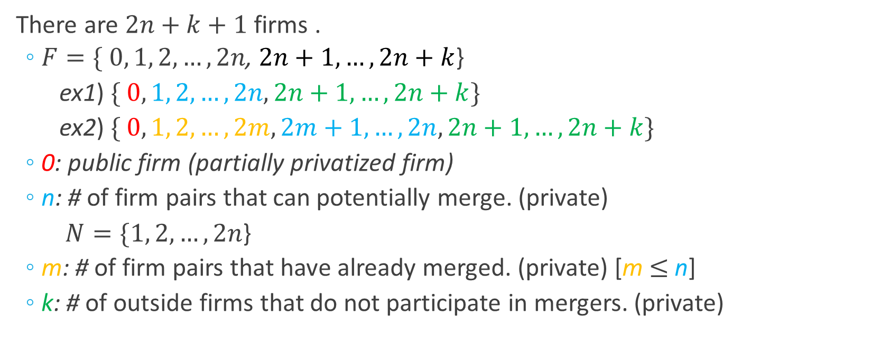
2. Basic model (1/5)
2. Basic Model
There are $2n+k+1$ firms .
  $F=\{ 0, 1, 2, …, 2n$, $2n+1, …, 2n+k$}
  ex1) $\{ 0, 1, 2, …,2n, 2n+1, …, 2n+k\}$
  ex2) $\{ 0, 1, 2, …,2m, 2m+1,…, 2n,2n+1, …, 2n+k\}$
  0: public firm (partially privatized firm)
  n: # of firm pairs that can potentially merge. (private)
  $N=\{1, 2, …, 2n$}
  m: # of firm pairs that have already merged. (private) [m$≤$n]
  k: # of outside firms that do not participate in mergers. (private)
Notes:
$n$ represents the number of firm pairs contemplating mergers.
$k$ represents the number of outsider firms that do not participate in mergers because of some exogenously given reasons.
$m$ represents the number of firm pairs currently merged.
And this is less than or equal to $n$.

Slide 12
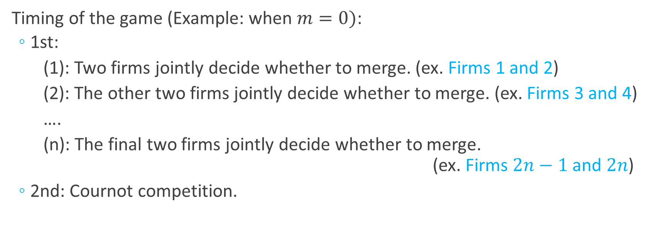
2. Basic model (2/5)
2. Basic Model
Timing of the game (Example: when $m=0)$:
  1st:
  (1): Two firms jointly decide whether to merge. (ex. Firms 1 and 2)
  (2): The other two firms jointly decide whether to merge. (ex. Firms 3 and 4)
  ….
  (n): The final two firms jointly decide whether to merge. (ex. Firms $2n−1$ and $2n$)
  2nd: Cournot competition.
Notes:
O.K. In this slide, let me explain the timing of the game.
First, two firms jointly decide whether to merge. For example, when $m$ equals to zero, firms 1 and 2 determine whether to merge.
Next, two other firms jointly decide whether to merge.
After repeating these processes, the final two firms $2n−1$ and $2n$ jointly decide whether to merge.
After this stage, the firms engage in Cournot competition.

Slide 13
2. Basic model (3/5)
2. Basic Model
After merger, the firms maximize their joint profit levels.
The equilibrium concept is subgame perfect Nash equilibrium.
The players approve merger if the final joint profit is greater than when the merger is not approved.
→ Reduced form of the negotiation game
We assume that mergers with three or four firms cannot occur, due to antitrust restrictions.
Notes:
O.K. In this slide, let me explain the timing of the game.
First, two firms jointly decide whether to merge. For example, when $m$ equals to zero, firms 1 and 2 determine whether to merge.
Next, two other firms jointly decide whether to merge.
After repeating these processes, the final two firms $2n−1$ and $2n$ jointly decide whether to merge.
After this stage, the firms engage in Cournot competition.

Slide 14
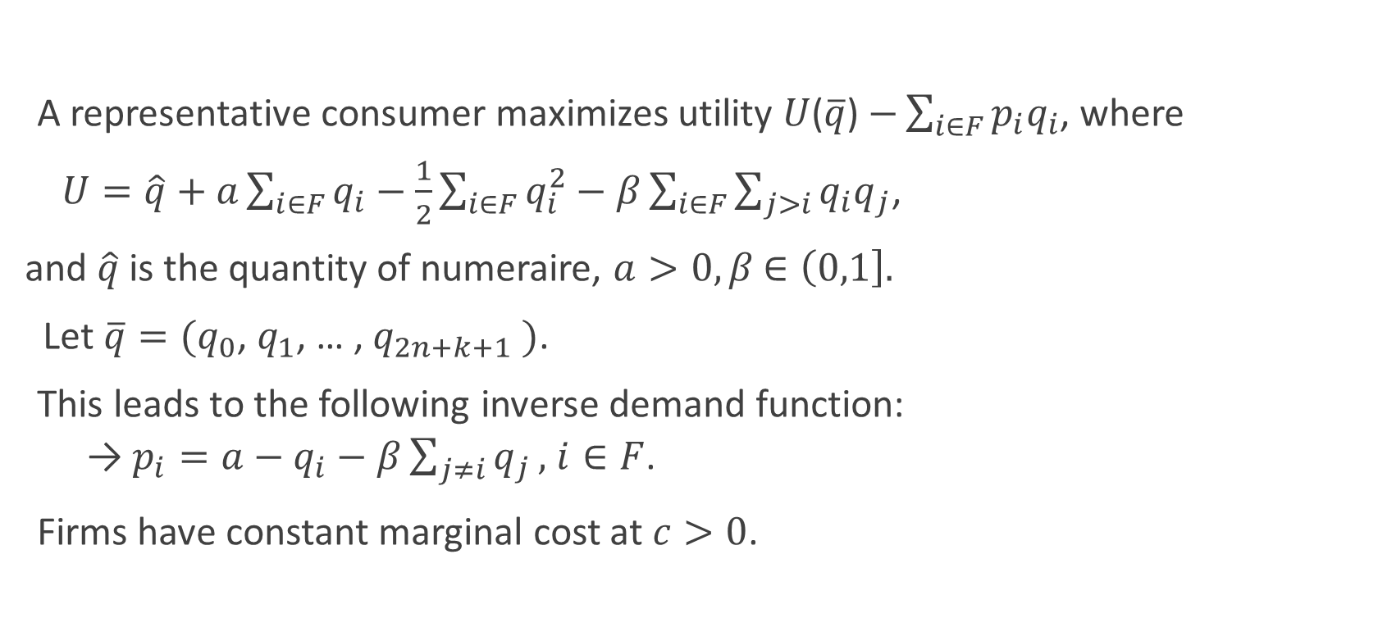
2. Basic model (4/5)
2. Basic Model
A representative consumer maximizes utility $U$($\overline{q}$) $−\sum_{i∈F}{p_{i}q_{i}}$, where
$U=\hat{q}+$ $a\sum_{i∈F}{q_{i}}$ $−$ $\frac{1}{2}\sum_{i∈F}{q_{i}^{2}}−β\sum_{i∈F}{\sum_{j>i}{q_{i}q_{j}}}$,
and $\hat{q}$ is the quantity of numeraire, $a>0,β$ $∈\left(0,1\right].$
Let $\overline{q}=(q_{0}\text{, }q_{1}\text{, … , }q_{2n+k+1} )$.
This leads to the following inverse demand function:
  →$p_{i}=a−q_{i}−β\sum_{j≠i}{q_{j}},$ $i∈F$.
Firms have constant marginal cost at $c>0$.
Notes:
Next, let me explain the demand function.
The inverse demand function becomes like this.
In this expression, $β$ （ベータ）represents the degree of product differentiation.
$β$ ($0≤β≤1$) is between zero and one ($0<β≤1$).

Slide 15
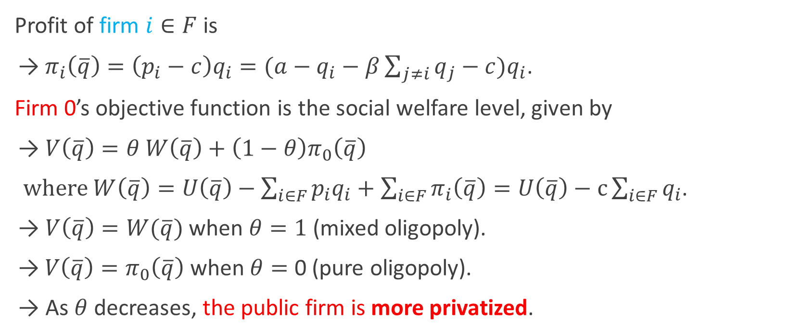
2. Basic model (5/5)
2. Basic Model
Profit of firm $i∈F$ is
→$π_{i}\left(\overline{q}\right)=\left(p_{i}−c\right)q_{i}=(a−q_{i}−β\sum_{j≠i}{q_{j}}−c)q_{i}$.
Firm 0’s objective function is the social welfare level, given by
→ $V\left(\overline{q}\right)=θ W\left(\overline{q}\right)+\left(1−θ\right)π_{0}\left(\overline{q}\right)$
where $W\left(\overline{q}\right)=U\left(\overline{q}\right)−\sum_{i∈F}{p_{i}q_{i}}+\sum_{i∈F}{π_{i}\left(\overline{q}\right)}=U\left(\overline{q}\right)−c\sum_{i∈F}{q_{i}}$.
→ $V\left(\overline{q}\right)=W(\overline{q})$ when $θ=1$ (mixed oligopoly).
→$V\left(\overline{q}\right)=π_{0}\left(\overline{q}\right)$ when $θ=$ 0 (pure oligopoly).
→ As $θ$ decreases, the public firm is more privatized.
Notes:
Finally, I’d like to explain the profit functions of firms.
There are three kinds, firm zero’s, merged firm’s, and non-merged firm’s.
The profit function of the non-merged firm is price minus cost times its quantity.
The profit function of merged firm is the joint profit of individual firms.

Slide 16
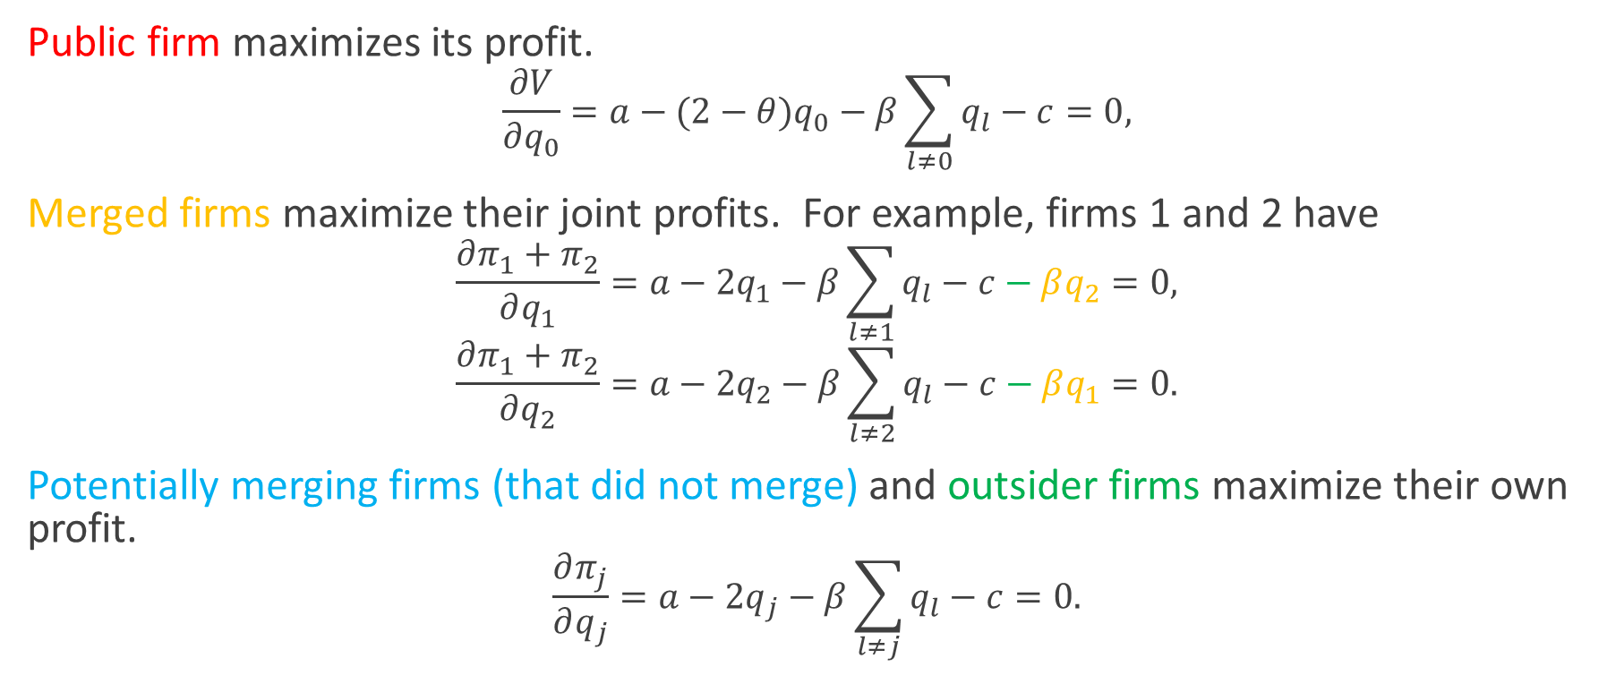
Equilibrium analysis
3. Equilibrium
Public firm maximizes its profit.
$$\frac{∂V}{∂q_{0}}=a−(2−θ)q_{0}−β\sum_{l≠0}{q_{l}}−c=0,$$
Merged firms maximize their joint profits. For example, firms 1 and 2 have
$$\frac{∂π_{1}+π_{2}}{∂q_{1}}=a−2q_{1}−β\sum_{l≠1}{q_{l}}−c−βq_{2}=0,$$
$$\frac{∂π_{1}+π_{2}}{∂q_{2}}=a−2q_{2}−β\sum_{l≠2}{q_{l}}−c−βq_{1}=0.$$
Potentially merging firms (that did not merge) and outsider firms maximize their own profit.
$$\frac{∂π_{j}}{∂q_{j}}=a−2q_{j}−β\sum_{l≠j}{q_{l}}−c=0.$$
Notes:
From now on, let us derive the SPNE of the game.
The game is solved by backward induction.
To solve the game, we consider the Cournot competition among firms, given that $2m$ firms have already merged with their pairs.
Differe(‘)nti(シュ)ating the profit functions with respect to its quantity, we have the equilibrium quantities and profits.

Slide 17
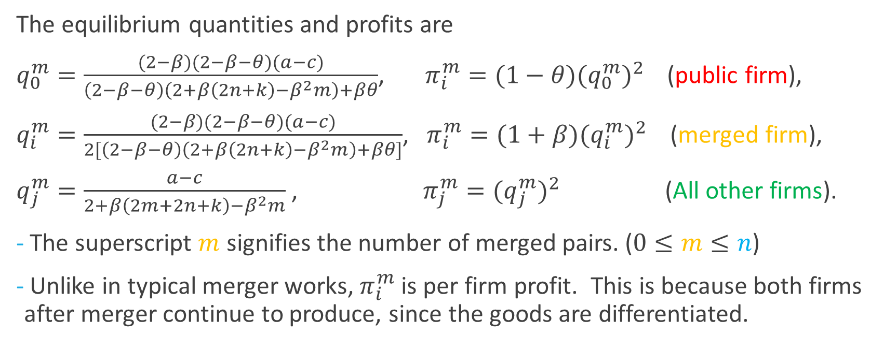
Equilibrium analysis
3. Equilibrium
The equilibrium quantities and profits are
$q_{0}^{m}=\frac{(2−β)(2−β−θ)(a−c)}{\left(2−β−θ\right)\left(2+β\left(2n+k\right)−β^{2}m\right)+βθ}$, $π_{i}^{m}=(1−θ)(q_{0}^{m})^{2}$ (public firm),
$q_{i}^{m}=\frac{(2−β)(2−β−θ)(a−c)}{2[\left(2−β−θ\right)\left(2+β\left(2n+k\right)−β^{2}m\right)+βθ]}$, $π_{i}^{m}=(1+β)(q_{i}^{m})^{2}$ (merged firm),
$q_{j}^{m}=\frac{a−c}{2+β\left(2m+2n+k\right)−β^{2}m}$ , $π_{j}^{m}=(q_{j}^{m})^{2}$ (All other firms).
The superscript $m$ signifies the number of merged pairs. ($0≤m≤n$)
Unlike in typical merger works, $π_{i}^{m}$ is per firm profit. This is because both firms after merger continue to produce, since the goods are differentiated.

Slide 18
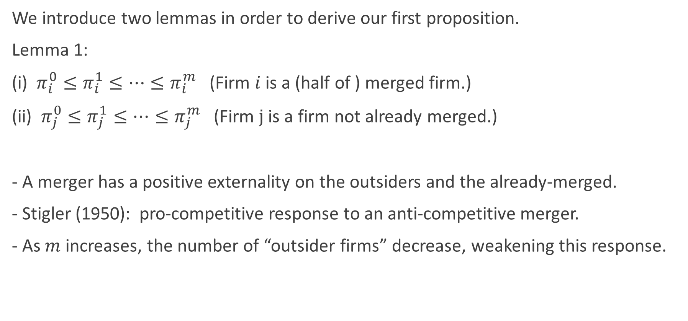
Equilibrium: Lemma 1
3. Equilibrium
We introduce two lemmas in order to derive our first proposition.
Lemma 1:
(i) $π_{i}^{0}≤π_{i}^{1}≤…≤π_{i}^{m}$ (Firm $i$ is a (half of ) merged firm.)
(ii) $π_{j}^{0}≤π_{j}^{1}≤…≤π_{j}^{m}$ (Firm $j$ is a firm not already merged.)
- A merger has a positive externality on the outsiders and the already-merged.
- Stigler (1950): pro-competitive response to an anti-competitive merger.
- As $m$ increases, the number of “outsider firms” decrease, weakening this response.

Slide 19
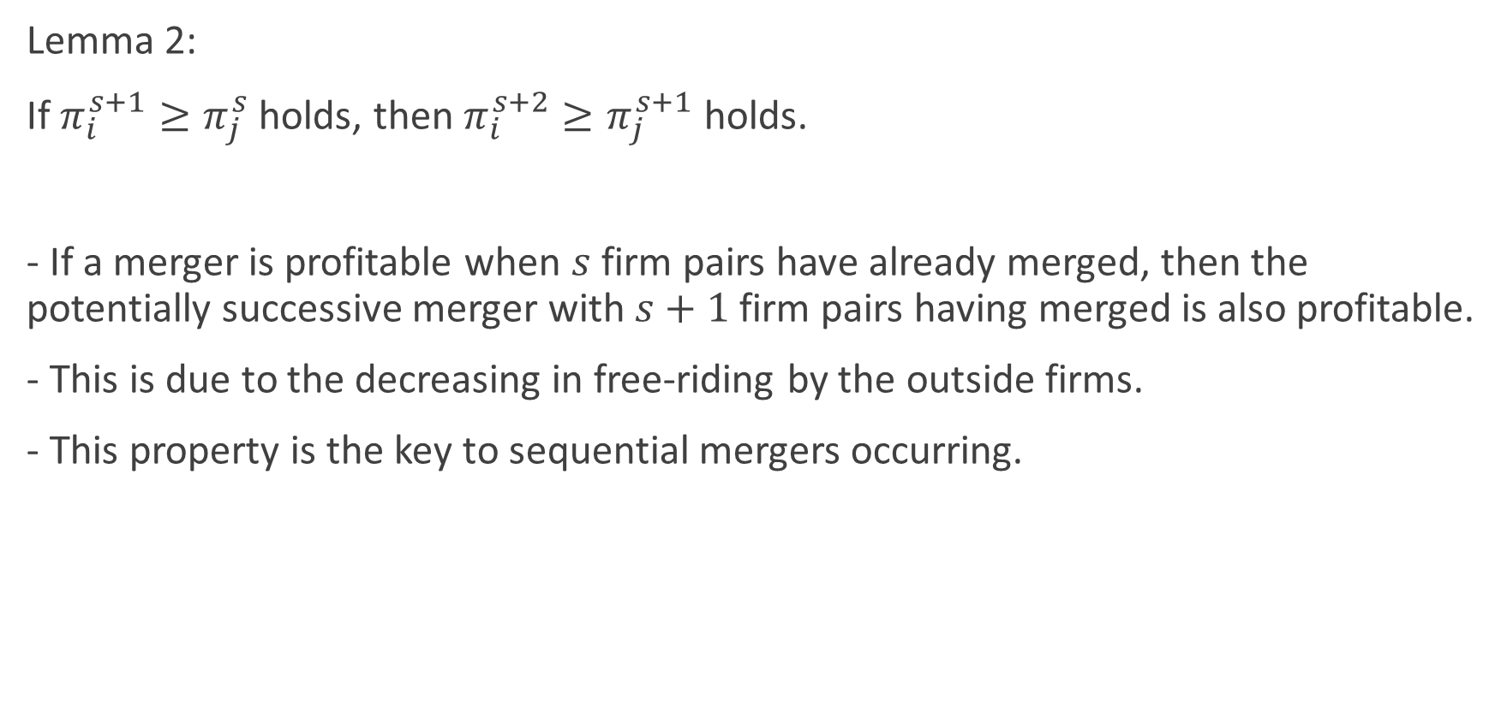
Equilibrium: Lemma 2
3. Equilibrium
Lemma 2:
If $π_{i}^{s+1}≥π_{j}^{s}$ holds, then $π_{i}^{s+2}≥π_{j}^{s+1}$ holds.
- If a merger is profitable when $s$firm pairs have already merged, then the potentially successive merger with $s+1$firm pairs having merged is also profitable.
- This is due to the decreasing in free-riding by the outside firms.
- This property is the key to sequential mergers occurring.

Slide 20
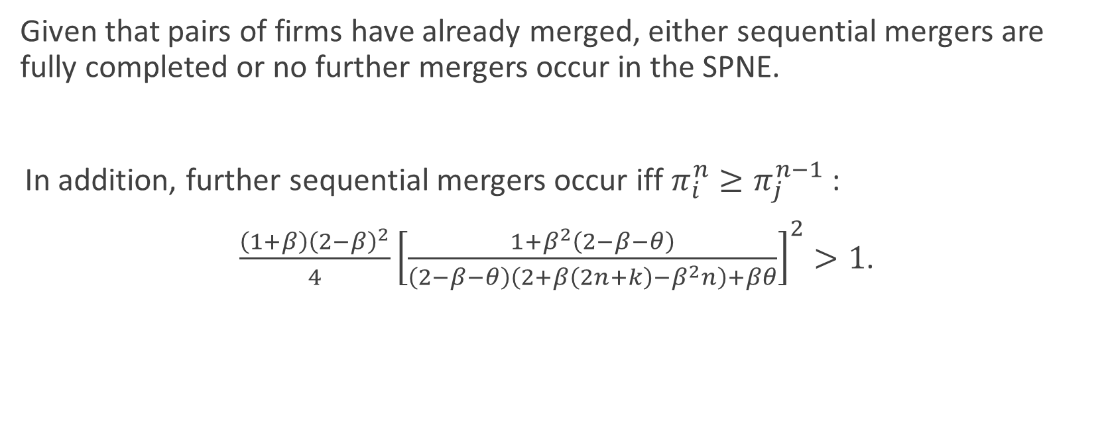
Proposition 1: Result of
“sequential mergers or no mergers”
3. Equilibrium
Given that pairs of firms have already merged, either sequential mergers are fully completed or no further mergers occur in the SPNE.
In addition, further sequential mergers occur iff $π_{i}^{n}≥π_{j}^{n−1}$ :
$\frac{\left(1+β\right){\left(2−β\right)}^{2}}{4}{\left[\frac{1+β^{2}\left(2−β−θ\right)}{\left(2−β−θ\right)\left(2+β\left(2n+k\right)−β^{2}n\right)+βθ}\right]}^{2}>1$.
Notes:
Now, I present our propositions of this study.
First, given that pairs of firms have already merged, either sequential mergers are fully completed or no further mergers occur in the SPNE.
This proposition shows that to determine the equilibrium outcome, we only need to check whether the last merger pair of ﬁrms has an incentive to merge, regardless of the parameters.

Slide 21
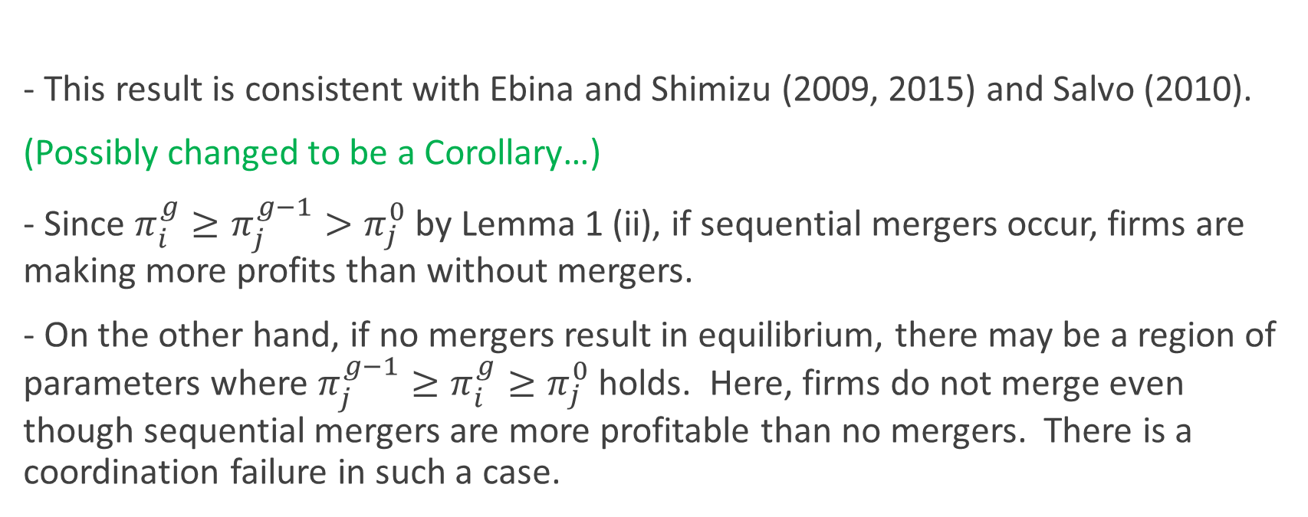
Comments on Proposition 1
3. Equilibrium
- This result is consistent with Ebina and Shimizu (2009, 2015) and Salvo (2010).
(Possibly changed to be a Corollary…)
- Since $π_{i}^{g}≥π_{j}^{g−1}>π_{j}^{0}$ by Lemma 1 (ii), if sequential mergers occur, firms are making more profits than without mergers.
- On the other hand, if no mergers result in equilibrium, there may be a region of parameters where $π_{j}^{g−1}≥π_{i}^{g}≥π_{j}^{0}$ holds. Here, firms do not merge even though sequential mergers are more profitable than no mergers. There is a coordination failure in such a case.

Slide 22
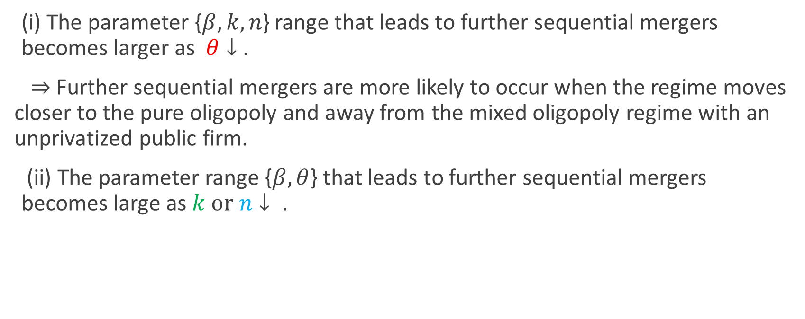
Proposition 3
3. Equilibrium
(i) The parameter {$β, k, n$} range that leads to further sequential mergers becomes larger as $θ↓$.
$⇒$ Further sequential mergers are more likely to occur when the regime moves closer to the pure oligopoly and away from the mixed oligopoly regime with an unprivatized public firm.
(ii) The parameter range {$β,θ$} that leads to further sequential mergers becomes large as $k or n↓ \text{.}$
Notes:
As $θ$ increases, ﬁrm 0 gives more weight on social welfare than on its own proﬁt.
Thus it produces more to increase welfare.
This yields that the free-ride effect by firm 0 is strengthened as $θ$ increases.
This is why our first result holds.

Slide 23
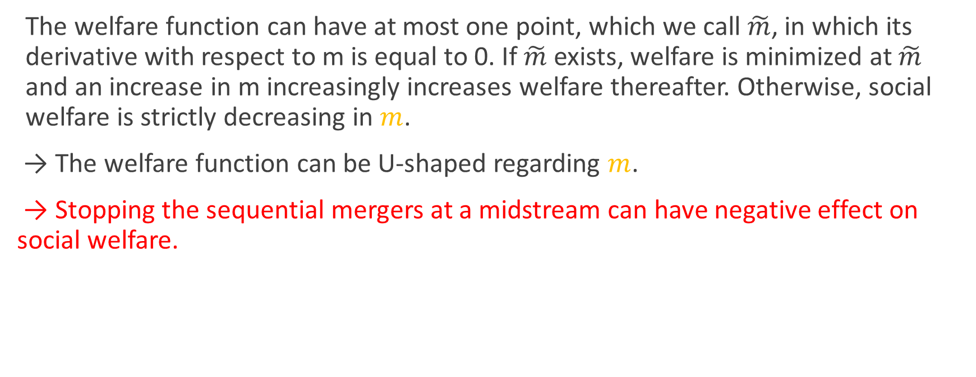
Proposition 4: Social welfare
3. Equilibrium
The welfare function can have at most one point, which we call $\tilde{m}$, in which its derivative with respect to m is equal to 0. If $\tilde{m}$ exists, welfare is minimized at $\tilde{m}$ and an increase in m increasingly increases welfare thereafter. Otherwise, social welfare is strictly decreasing in $m$.
→ The welfare function can be U-shaped regarding $m$.
→ Stopping the sequential mergers at a midstream can have negative effect on social welfare.
Notes:
I’d like to move on to the welfare implication of our model.
This proposition states that the social welfare function W can be U-shaped regarding m.
This finding implies that once a process of sequential mergers has started and is now at a midstream, then it may be better for the policymaker not to stop the merger.

Slide 24
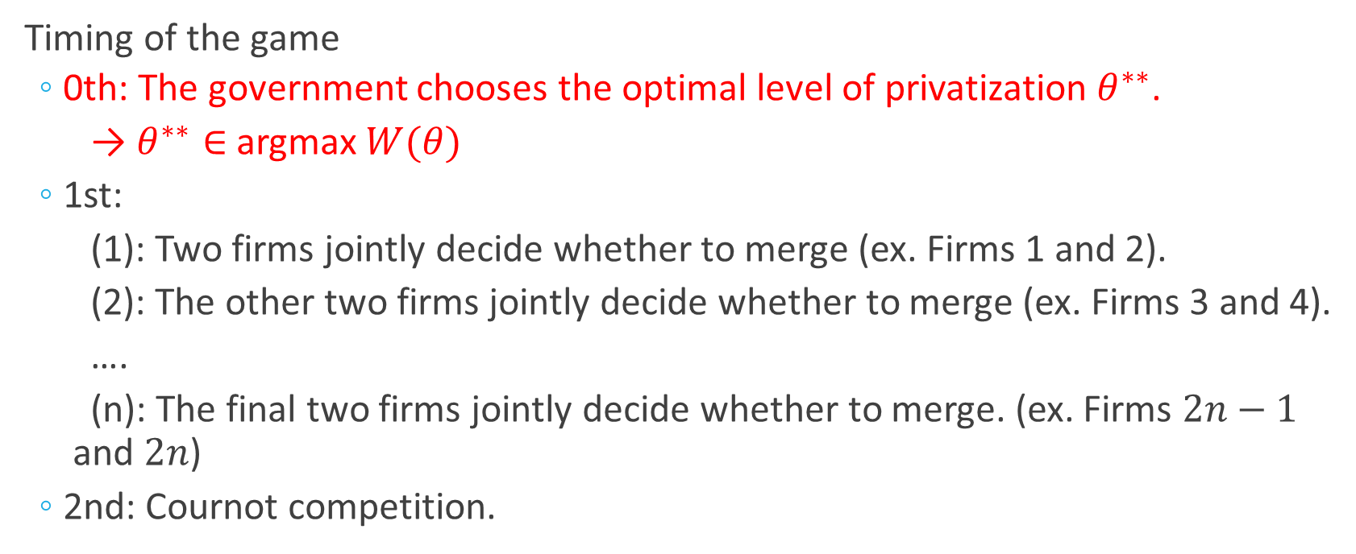
4. Full model: Incorporating the optimal level of privatization
4. Full Model
Timing of the game
  0th: The government chooses the optimal level of privatization $θ^{∗∗}$.
  → $θ^{∗∗}∈$ argmax $W(θ)$
  1st:
  (1): Two firms jointly decide whether to merge (ex. Firms 1 and 2).
  (2): The other two firms jointly decide whether to merge (ex. Firms 3 and 4).
  ….
  (n): The final two firms jointly decide whether to merge. (ex. Firms $2n−1$ and $2n$)
  2nd: Cournot competition.
Notes:
From now, we consider a situation where the government can choose an optimal level of privatization and investigate how the level of privatization affects a decision of sequential mergers or no mergers.
The advanced model adds the zeroth stage to the previous model.
At this stage, the government chooses the optimal level of privatization $θ^{∗}$ to maximize welfare.
The rest of the game is the same as in the previous case.

Slide 25
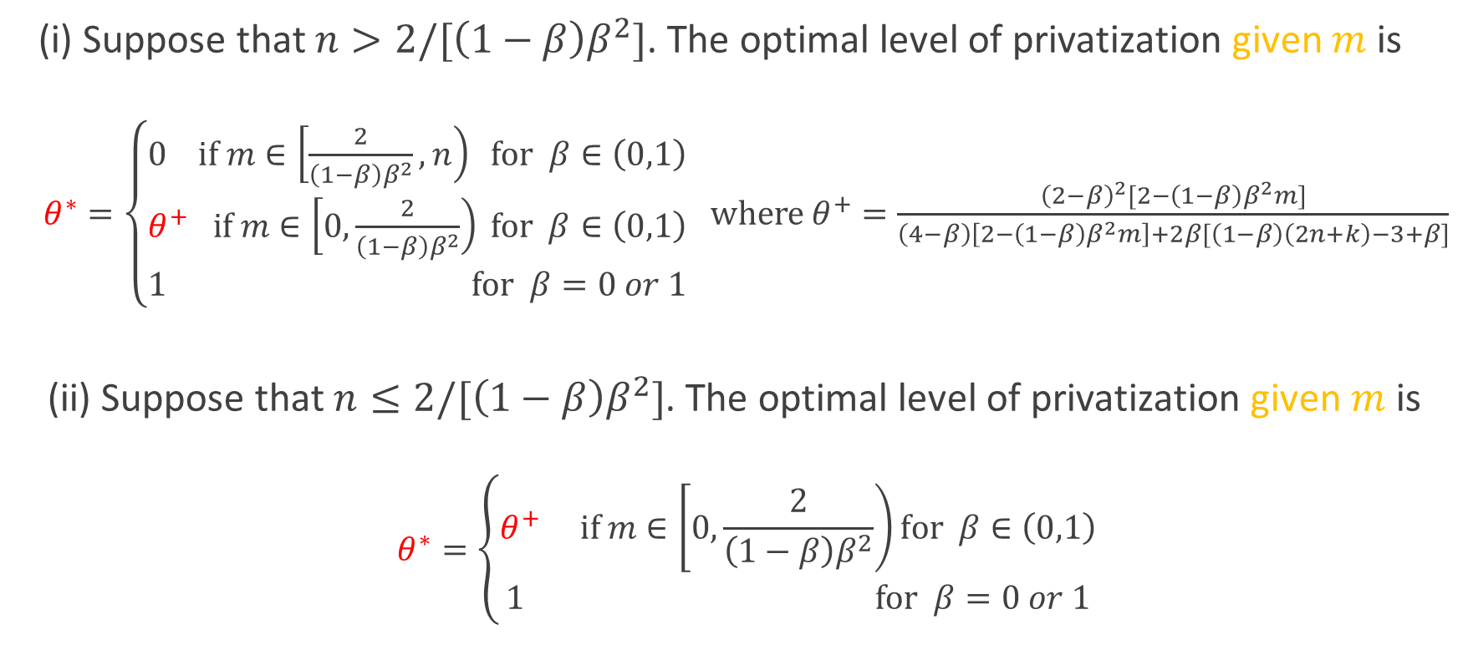
Proposition 6: Optimal level of privatization
4. Full Model
(i) Suppose that $n>2/[\left(1−β\right)β^{2}]$. The optimal level of privatization given $m$is
$θ^{∗}=\left\{\begin{aligned}0 if m∈\left[\frac{2}{\left(1−β\right)β^{2}},n\right) for β∈\left(0,1\right) \\ θ^{+} if m∈\left[0,\frac{2}{\left(1−β\right)β^{2}}\right) for β∈\left(0,1\right) \\ 1 for β=0 or 1\end{aligned}\right.$ where $θ^{+}=\frac{{\left(2−β\right)}^{2}[2−\left(1−β\right)β^{2}m]}{\left(4−β\right)\left[2−\left(1−β\right)β^{2}m\right]+2β[\left(1−β\right)\left(2n+k\right)−3+β]}$
(ii) Suppose that $n≤2/[\left(1−β\right)β^{2}]$. The optimal level of privatization given $m$is
$$θ^{∗}=\left\{\begin{aligned}θ^{+} if m∈\left[0,\frac{2}{\left(1−β\right)β^{2}}\right)for β∈\left(0,1\right) \\ 1 for β=0 or 1\end{aligned}\right.$$
Notes:
Proposition 6 shows the optimal level of privatization.
Depending on the number of potential merging firm pairs, it determines whether the case of perfect privatization exists or not.
But the fundamental property is the same between these two.
Regarding the first part, suppose that $n$ is larger than 2 over 1 minus (ベータ) $β$ times $β$ squared.
Then, (i) if $m$ is in this range, the optimal level of privatization is zero.
This is full privatization.

Slide 26
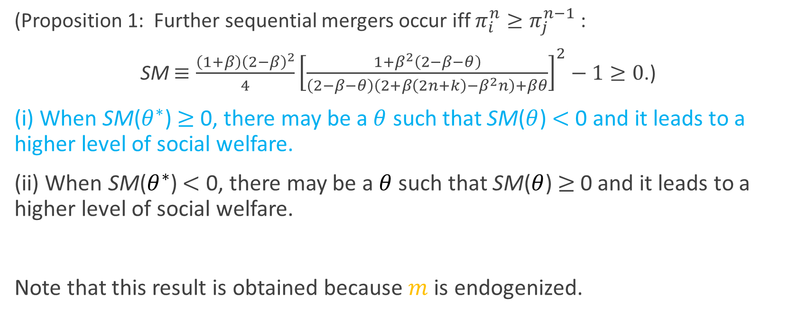
Proposition 7: Optimal level of privatization
4. Full Model
(Proposition 1: Further sequential mergers occur iff $π_{i}^{n}≥π_{j}^{n−1}$ :
SM $≡\frac{\left(1+β\right){\left(2−β\right)}^{2}}{4}{\left[\frac{1+β^{2}\left(2−β−θ\right)}{\left(2−β−θ\right)\left(2+β\left(2n+k\right)−β^{2}n\right)+βθ}\right]}^{2}−1≥0$.)
(i) When SM($θ^{∗}$) $≥$ 0, there may be a $θ$ such that SM($θ$) $<$ 0 and it leads to a higher level of social welfare.
(ii) When SM($θ^{∗}$) $<$ 0, there may be a $θ$ such that SM($θ$)$≥$ 0 and it leads to a higher level of social welfare.
Note that this result is obtained because $m$ is endogenized.
Notes:
Now, I present our propositions of this study.
First, given that pairs of firms have already merged, either sequential mergers are fully completed or no further mergers occur in the SPNE.
This proposition shows that to determine the equilibrium outcome, we only need to check whether the last merger pair of ﬁrms has an incentive to merge, regardless of the parameters.

Slide 27
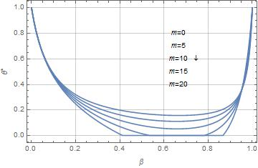
Numerical Result: Figure 1(a) (Proposition 6)
5. Numerical Analysis
Notes:
To clarify Proposition 6, we conduct a numerical example.
Figure 1 summarizes the result.
The horizontal axis represents（ベータ） $β$. The vertical axis represents the level of privatization $θ^{∗}$.
First, $θ^{∗}$ equals to 1 holds only when $β$ equals zero or one around here.
Next, as $m$ increases, there exists a region where the perfect privatization is optimal, that is $θ^{∗}$ equals to zero holds.
And, otherwise, $θ^{∗}$ is between zero and one inclusive.
This is partial privatization.

Slide 28
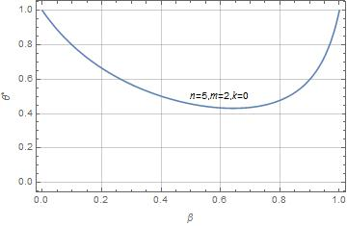
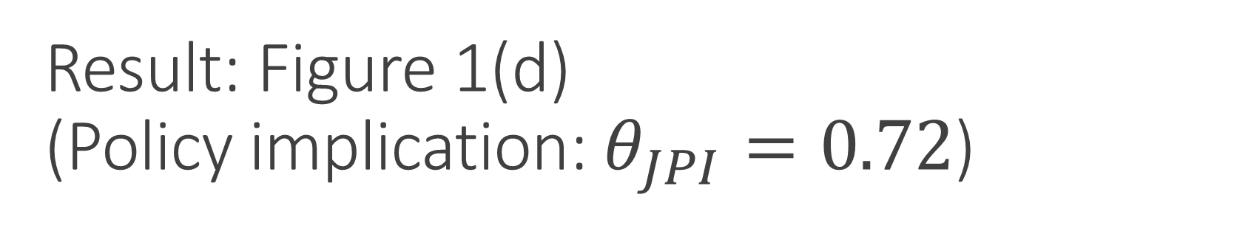
Result: Figure 1(d)
(Policy implication: $θ_{JPI}=0.72$)
5. Numerical Analysis
Notes:
Next, let us consider a policy implications based on our results.
The real world example is life insurance industry in Japan with JPI.
And $θ_{JPI}$ equals 0.72 (zero point seven two).

Slide 29
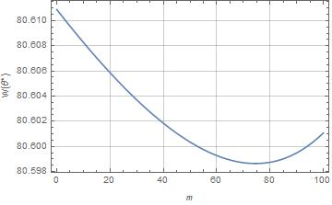
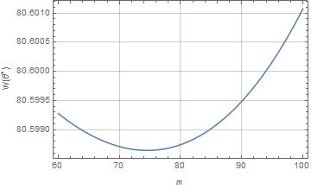
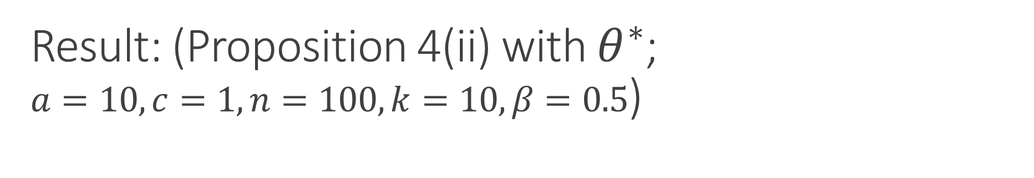
Result: (Proposition 4(ii) with $θ^{∗}$;
$a=10, c=1, n=100, k=10, β=0.5$)
5. Numerical Analysis
Notes:
Finally, in this slide, using the result of advanced model $θ^{∗}$, let me give numerical examples that supports Proposition.
Proposition 4 states that, given $θ$, the welfare function can be U-shaped.
Please take a look at Figure 3.
The horizontal axis represents $m$ and the vertical axis represents $W(θ^{∗})$.

Slide 30
Result: Figure 3 (Proposition 7)
5. Numerical Analysis
Notes:
Next, let us consider a policy implications based on our results.
The real world example is life insurance industry in Japan with JPI.
And $θ_{JPI}$ equals 0.72 (zero point seven two).

Slide 31
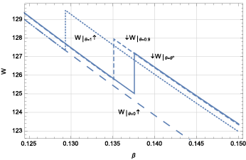
Result: Figure 3 (Proposition 7)
5. Numerical Analysis
Notes:
Next, let us consider a policy implications based on our results.
The real world example is life insurance industry in Japan with JPI.
And $θ_{JPI}$ equals 0.72 (zero point seven two).

Slide 32
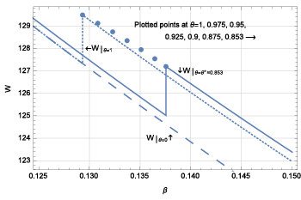
Result: Figure 3 (Proposition 7)
5. Numerical Analysis
Notes:
Next, let us consider a policy implications based on our results.
The real world example is life insurance industry in Japan with JPI.
And $θ_{JPI}$ equals 0.72 (zero point seven two).

Slide 33
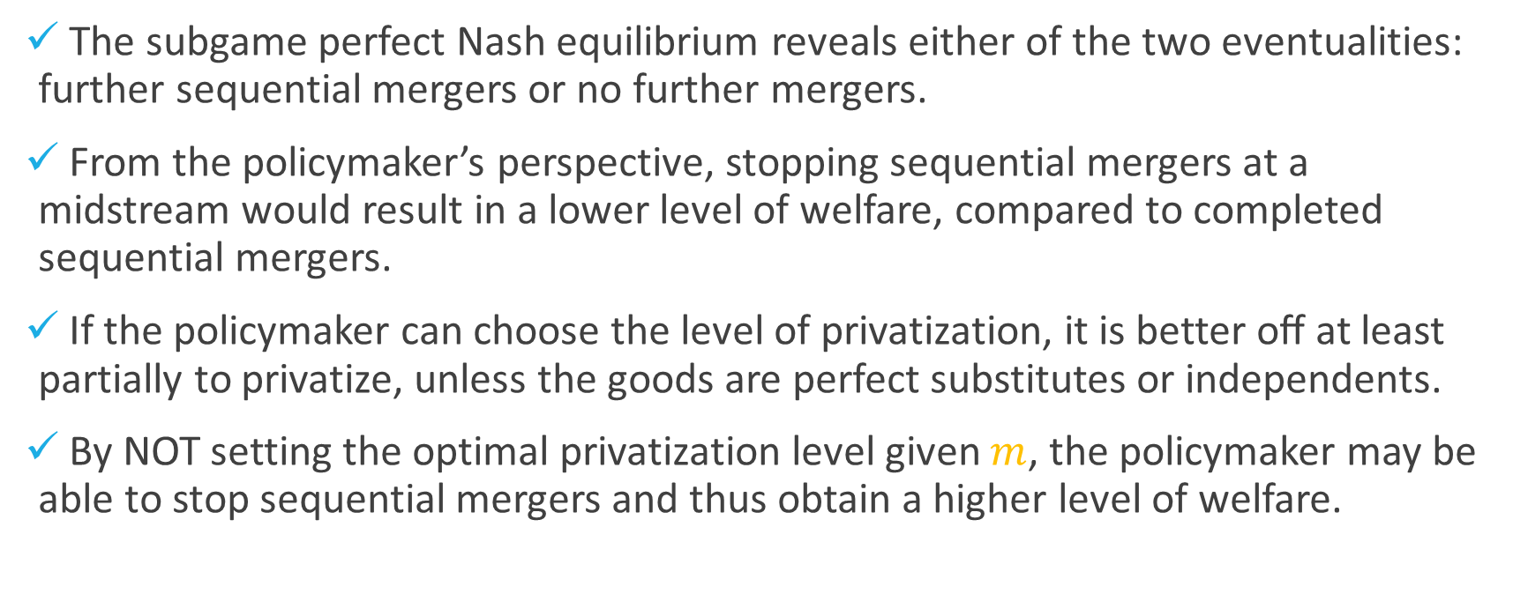
Concluding remarks
6. Conclusion
The subgame perfect Nash equilibrium reveals either of the two eventualities: further sequential mergers or no further mergers.
From the policymaker’s perspective, stopping sequential mergers at a midstream would result in a lower level of welfare, compared to completed sequential mergers.
If the policymaker can choose the level of privatization, it is better oﬀ at least partially to privatize, unless the goods are perfect substitutes or independents.
By NOT setting the optimal privatization level given $m$, the policymaker may be able to stop sequential mergers and thus obtain a higher level of welfare.
Notes:
Here is the wrap up of today’s presentation.
First,
Second,
Finally,
This is all I have for today. Thank you very much for your attention.

